Slide 1
Will AI kill us all?

Slide 2

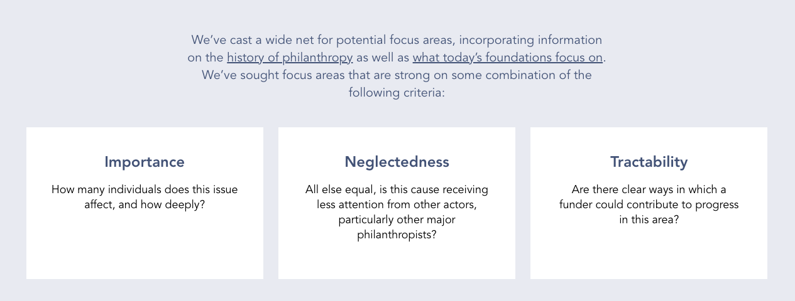

Slide 3
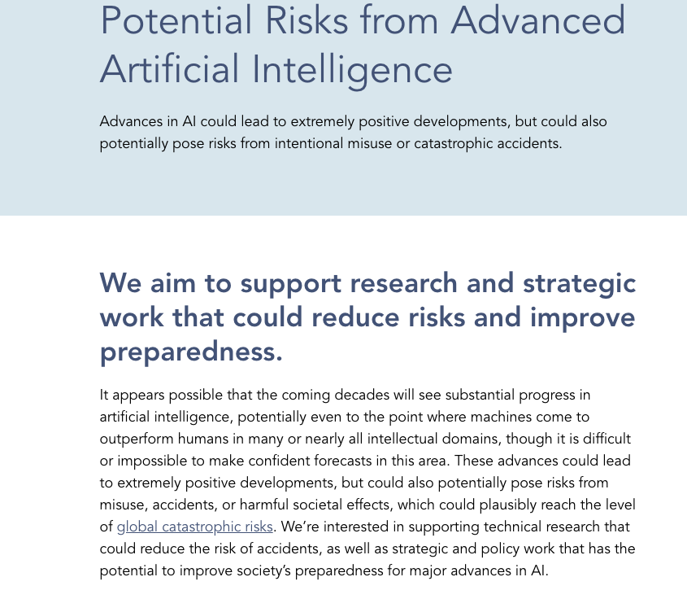

Slide 4
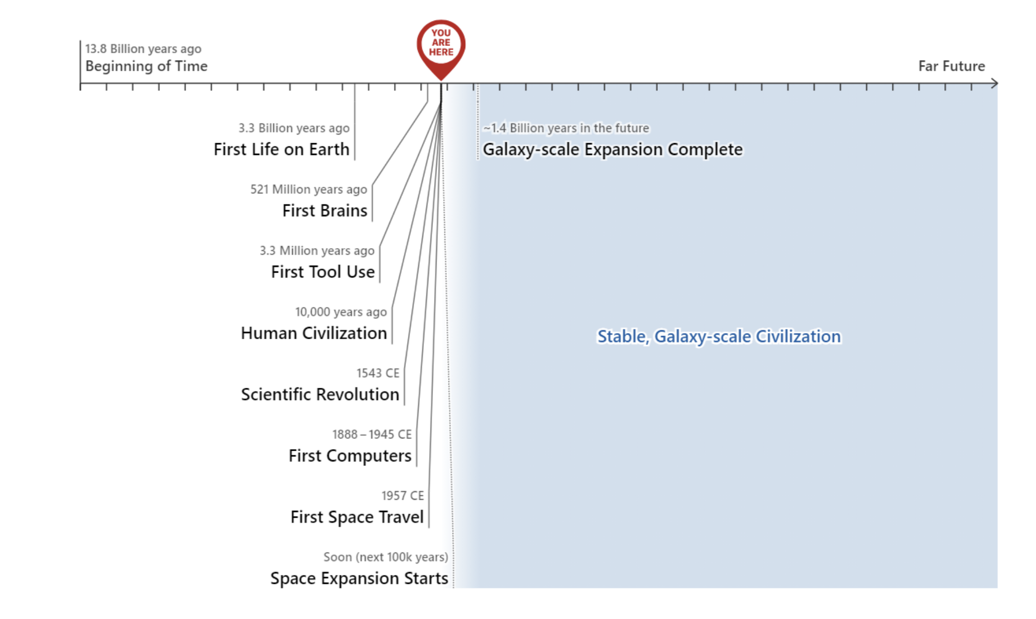
We're currently living through the fastest-growing time in history.

Slide 5
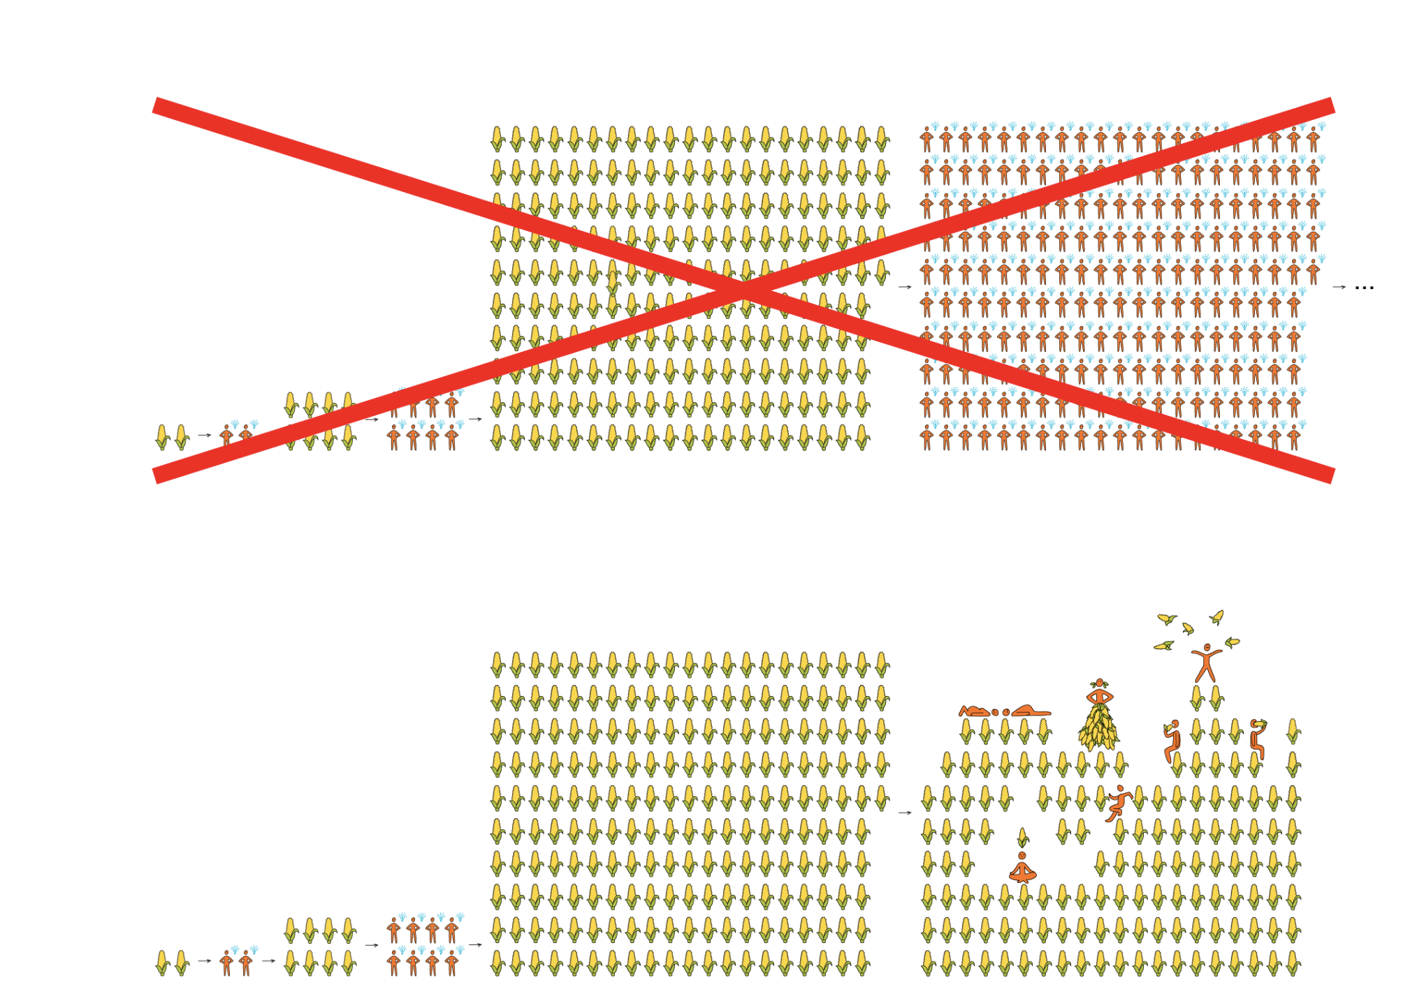
The long-run future could come much faster than we think

Slide 6
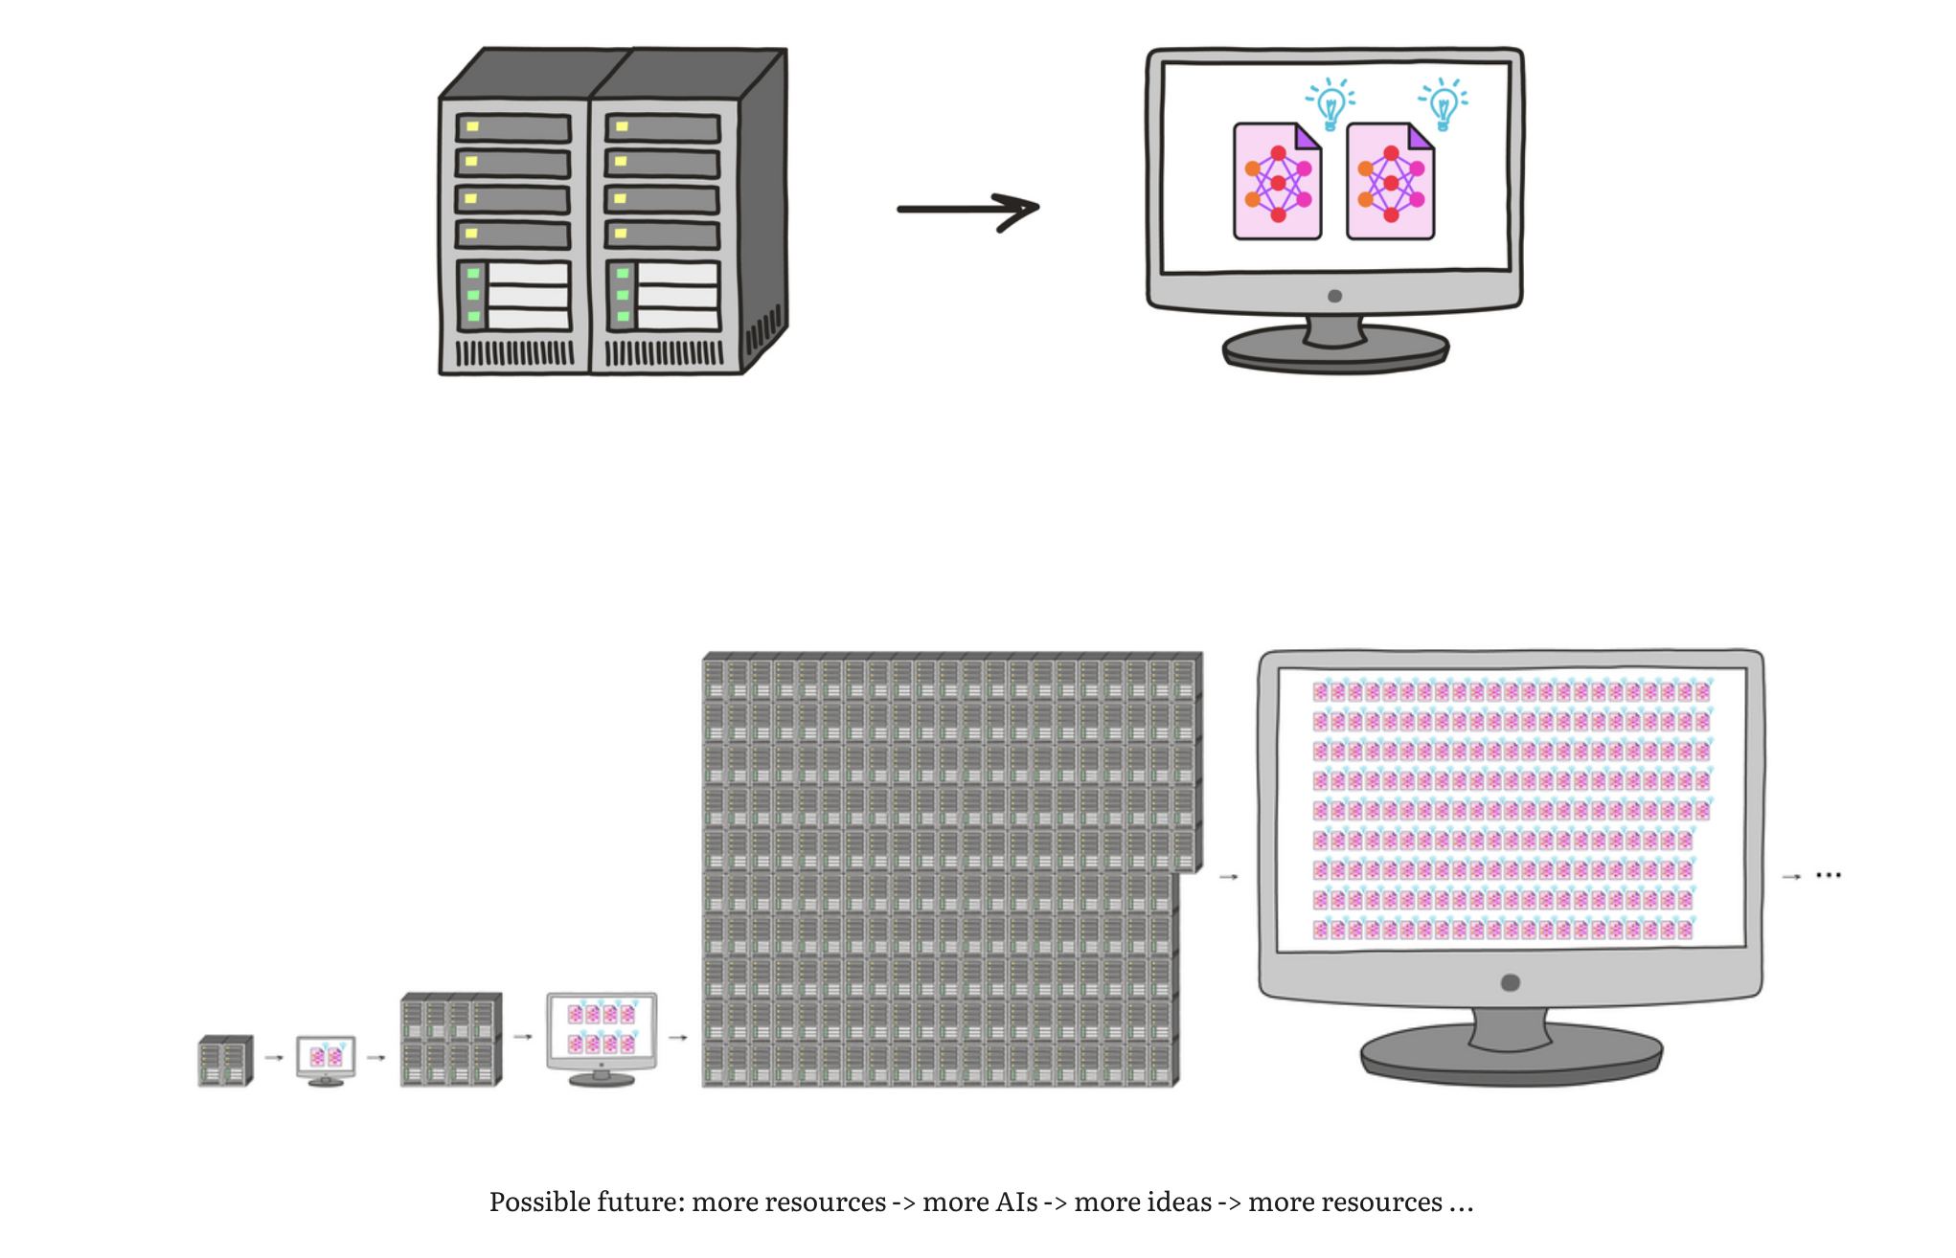
Possible future: more resources -> more AIs -> more ideas -> more resources ...

Slide 7
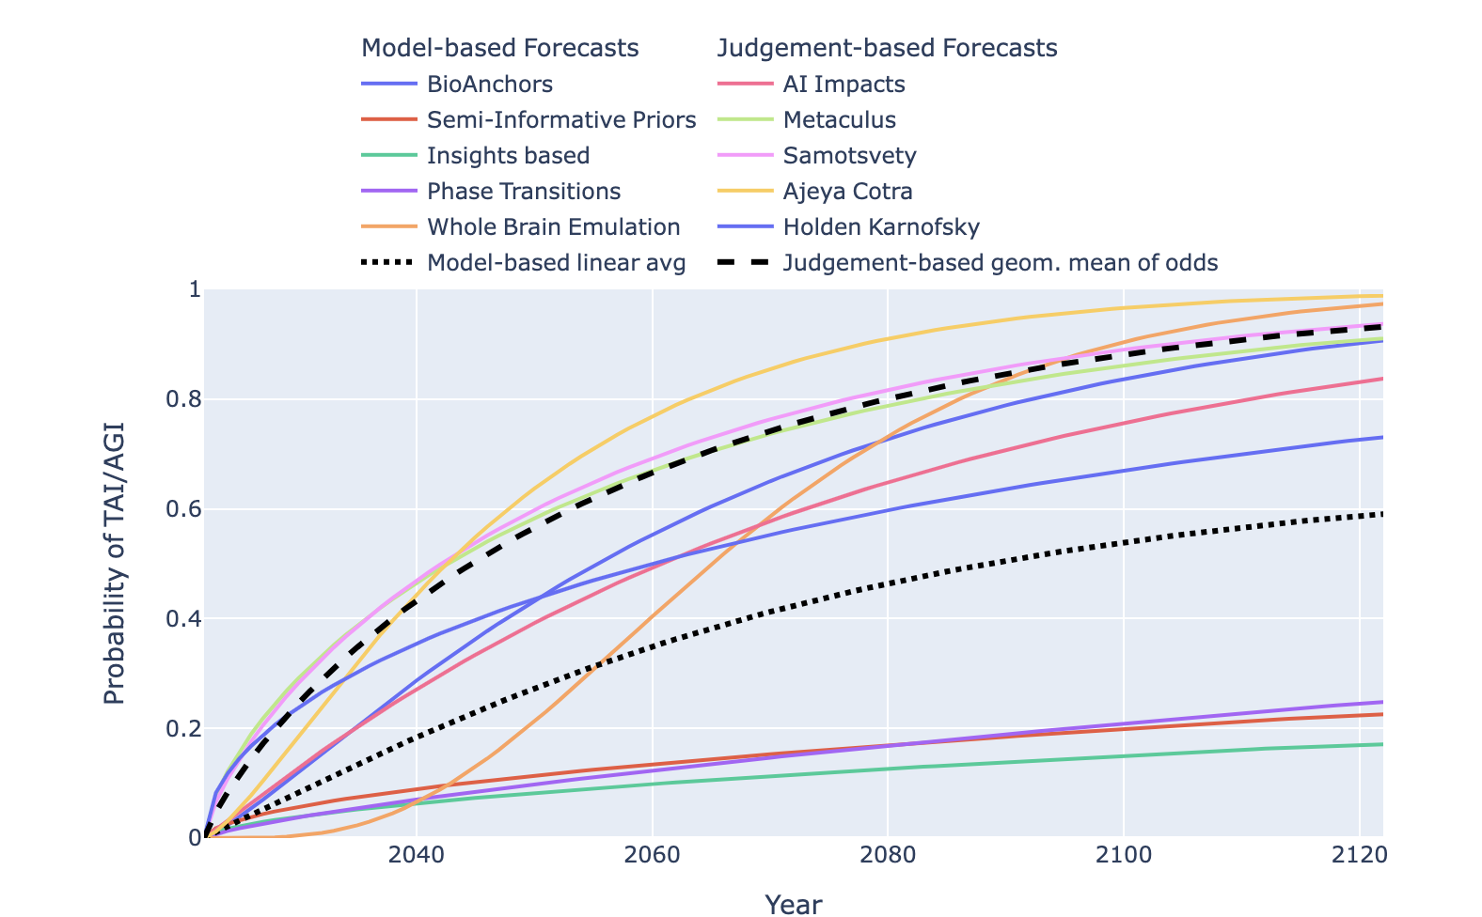
Transformative Artificial Intelligence timelines

Slide 8
The alignment problem from a deep learning perspective
Within the coming decades, artificial general intelligence (AGI) may surpass human capabilities at a wide range of important tasks.
AGIs could learn to pursue goals which are undesirable (i.e. misaligned) from a human perspective.
They could learn to act deceptively to receive higher reward, learn internally-represented goals which generalize beyond their training distributions, and pursue those goals using power-seeking strategies.
The deployment of misaligned AGIs might irreversibly undermine human control over the world.

Slide 9
Without specific countermeasures, the easiest path to transformative AI likely leads to AI takeover
The “racing forward” assumption: AI companies will aggressively attempt to train the most powerful and world-changing models that they can, without “pausing” progress before the point when these models could defeat all of humanity combined if they were so inclined.
The “HFDT scales far” assumption: If HFDT (human feedback on diverse task) is used to train larger and larger models on more and harder tasks, this will eventually result in models that can autonomously advance frontier science and technology R&D, and continue to get even more powerful beyond that; this doesn’t require changing the high-level training strategy itself, only the size of the model and the nature of the tasks.
The “naive safety effort” assumption: AI companies put substantial effort into ensuring their models behave safely in “day-to-day” situations, but are not especially vigilant about the threat of full-blown AI takeover, and take only the most basic and obvious actions against that threat.

Slide 10
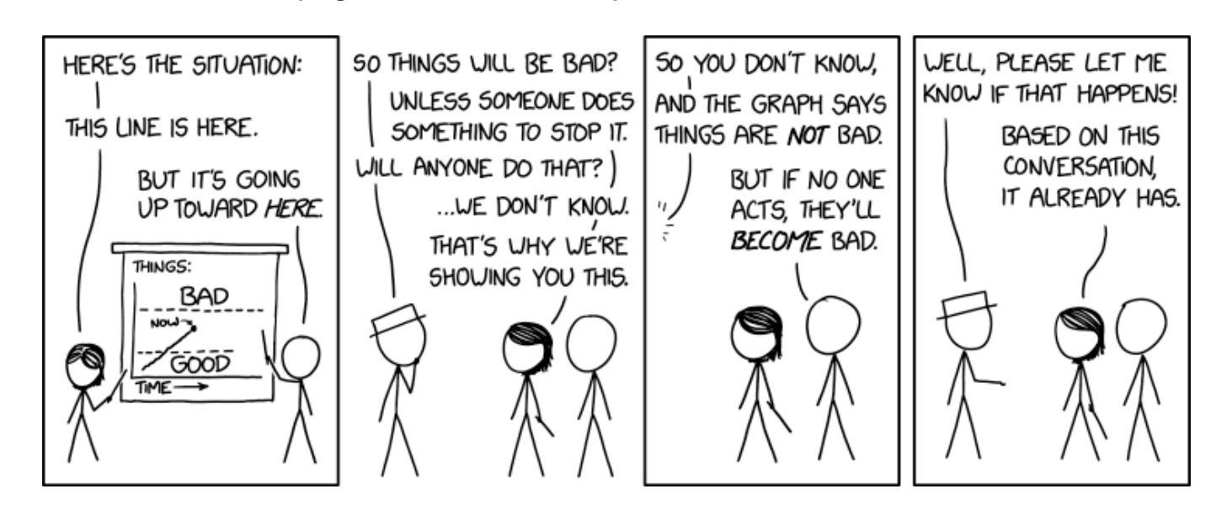
What would happen without preventive measures beyond basic and obvious ones

Slide 11
Ultimately, my claims are about topics that simply have no "field" of experts devoted to studying them. That, in and of itself, is a scary fact, and something that I hope will eventually change.

Slide 12
Call to vigilance
Finding ways to interact more with, and learn more about, key topics/fields/industries such as AI (for obvious reasons), science and technology generally (as a lot of the "most important century" hypothesis runs through an explosion in scientific and technological advancement), and relevant areas of policy and national security.
Taking opportunities (when you see them) to move your career in a direction that is more likely to be relevant (some thoughts of mine on this are here; also see 80,000 Hours).
Connecting with other people interested in these topics (I believe this has been one of the biggest drivers of people coming to do high-impact work in the past). Currently, I think the effective altruism community is the best venue for this, and you can learn about how to connect with people via the Centre for Effective Altruism (see the "Get involved" dropdown). If new ways of connecting with people come up in the future, I will likely post them on Cold Takes.
And of course, taking any opportunities you see for robustly helpful actions.

